Slide 1
UX Fundamentals
The Scope Plane

Slide 2
The Five Plane Model
Strategy
Scope
Structure
Skelton
Surface
Abstract
Concrete
Notes:
Developed by Garrett Jessie James, the five plane model is a UCD approach very will suited to understanding good UX principles. It builds five planes of activity into the development process for UX starting from the most abstract user centred to a working prototype at the end of development.

Slide 3
THE SCOPE PLANE
The Scope plane takes the findings of the Strategy plane and aligns them
  It ensures we know what we are building
  Aligning our expectations against the user’s
Requirements allow us to lay out the deliverables and objectives
  Setting out the entire scope mapped out for the project
Establish what you are building – ensure everyone understands
  Identify requirements, ensure they match user needs
  Not possible user needs
  Set out a timeline and stop scope creep
We move from why are we making this product to:
  What are we going to make
Notes:
Based on evidence we now need to clearly set out our objectives for the development of the product – our evidence from the Strategy plane should provide significant evidence to support or deny early assumptions. The final product must stop being a nebulous construct in a senior stakeholders mind and reach a concrete framework to take towards development.

Slide 4
In this section we will examine:
Technical Requirements
Content Requirements
Scenarios
Task Analysis
Prioritise (MoSCoW)

Slide 5
Traditional requirement specifications can be enhanced with UX:
  Feature requirements can be based on data collected during the user research phase
  User research complements market research data and other sources of product development information
    Basing feature requirements on actual user data
    Reducing the risk of investing resources in unwanted features
    Increases the likelihood of adding features that will drive sales
  UX-specific requirements can be added to the specification
    Adding UX requirements becomes a business priority
    Alongside other product attributes
    Ensuring UX improvements are delivered when the product ships
TECHNICAL Requirements
Notes:
Traditional requirement specifications can be enhanced with UX information in two main ways:
Feature requirements can be based on information collected during the user research phase. Here, user research complements market research data and other sources of product development information. Basing feature requirements on actual user data collected during research reduces the risk of investing resources in unwanted features and increases the likelihood of adding features that will drive sales.
UX-specific requirements can be added to the requirement specification. By adding UX requirements, UX becomes a priority alongside other product attributes and UX improvements are delivered when the product ships.

Slide 6
Content Requirements
Content requirements refer to text, images, audio, and text
  These pieces of content work together to fulfil a requirement
    e.g. a piece supporting a film may require text, image/video, and links to external ratings
  At this point we care about the content – not the format
    Never get caught up by this – that is for the surface phase
  As we consider data consider size and performance
    Especially important for mobile users
  Identify who is responsible for content
  Identify the frequency of updates
    Is this static, how often does it change, who changes it
  This will be tedious but we have to do it

Slide 7
One of the first steps to effective IA is content analysis determine:
  Content you have
    Learn what you have, avoid duplication
  Content you need
    For each task analyse content required, who is responsible for it
    Who will provide content
  Communicating about content
    Build a content spreadsheet
    Colour code according to popularity
Content

Slide 8
Learning what content you have will help you:
  Understand the subject
    If you’re working on a new site, or a subject you don’t have much experience with
  Look at it with fresh eyes:
    A great refresher and gives you a chance to look at your content
  Clean up:
    Clean up old, out-of-date, and inaccurate content
  Migrate it:
    You need to know what you have so you don’t lose anything in the migration
  Manage progress:
    Keep track of things like what content has been rewritten
Content you have

Slide 9
To manage content you will need to perform some form of audit:
  Full content inventory – which includes all
    Page, downloadable objects e.g. PDF files, documents,
    Embedded objects, such as video or audio other content
      In blogging sites this may include reader comments
  Partial content inventory
    This collects information for a number of levels of the site
      Though it may show some parts of the site in more detail
    It is a good practical approach for very large sites
  Content audit
    Is a sample across the site
    It may collect details for the first couple of levels of a site
      Then details for different page types in each section
Conduct a content inventory

Slide 10
CONTENT YOU NEED
Whether working on a new design or re-launching think content
  The content you choose should:
    Meet the needs of the people using your product
    Help achieve your project goals
Consider approaching content creation in the following ways:
  Current behaviours
  User research
  Your own ideas for content

Slide 11
CURRENT BEHAVIOUR
Examine what users are currently viewing and doing
  From site metrics
  Competitor analysis
Do not just focus on immediate data
  Check what happens at different times of the year
  When new content is added – does it peak and not get used again?
Prioritise popular content – it becomes popular because of users
  Provide better links to existing and related content
  Investigate social networking trends
    Use verbs and action from the research phase

Slide 12
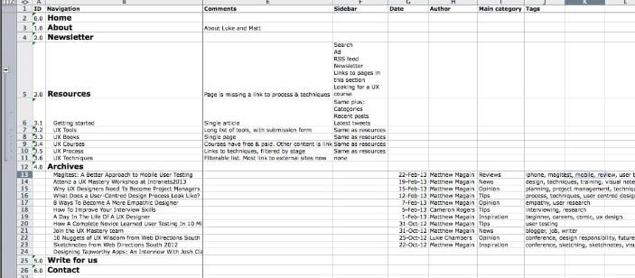
Build a spreadsheet of content
  Use analytics to investigate who is doing what
  Categorise content
  Understand popularity
Content Planning

Slide 13
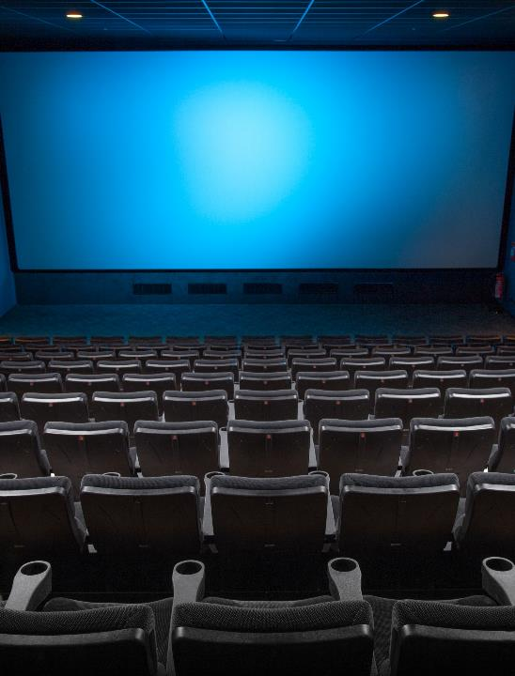
Activity: Content for the Cinema website
Use our User Personas to identify the following
  The landing page for our movie goers app
    What should be on it
    What and how often will it change
  Consider a page showing film times at a cinema
    Identify content, and frequency of change
  Consider the cinema information page,
    What content is needed
    Who will use it and why

Slide 14


Scenarios
Scenarios describe the stories and context behind why a specific user or user group comes to your site
They note the goals and questions to be achieved and sometimes define the possibilities of how the user can achieve them on the site
Scenarios are critical both for designing an interface and for usability testing
Notes:
Scenarios describe the stories and context behind why a specific user or user group comes to your site. They note the goals and questions to be achieved and sometimes define the possibilities of how the user(s) can achieve them on the site.
Scenarios are critical both for designing an interface and for usability testing.

Slide 15

Scenario Types
Goal or task based scenarios
Elaborated scenarios
Full scale task scenarios
Notes:
Goal- or Task-Based Scenarios state only what the user wants to do. Do not include any information on how the user would complete the scenario. These scenarios are useful in helping to define your site architecture and content. You should give these types of scenarios to users in a usability test. It gives them a reason and a goal for going to the site, but it lets them show you how they would use the site to accomplish that goal.
Example: A parent is worried about a ten-year old refusing to drink milk and wants to know if it really makes a difference that the child is getting very little calcium.
Example: You are traveling to Seattle for your job next week and you want to check on the amount you can be reimbursed for meals and other expenses.
Elaborated Scenarios give more user story details. These details give the Web team a deeper understanding of the users and users’ characteristics that may help or hinder site interaction. Knowing this information, the team is more likely to develop content, functionality, and site behaviour that users find comfortable and easy to work with. (example on next page)

Slide 16

Example: You are traveling to York for your job next week and you want to check what can be reimbursed through expenses.
Goal- or Task-Based Scenarios

Slide 17
Example: Mr. and Mrs. Smith are retired schoolteachers who are now in their 70s. Their pension is an important part of their income. They’ve just downsized from a large house to a small apartment on the outskirts of town.
They know that they need to notify lots of organisations about their new address, including their pension company.
If it is easy and safe enough, they would like to use the computer to notify the pension company of their move, however, they are somewhat nervous about doing a task like this by computer.
They never used computers in their jobs, but their son gave them an iPad for Christmas and showed them how to use email and go to websites.
They have never been to the pension company’s website, so they don't know how it is organized.
Also, they are reluctant to give out personal information online, so they want to know how safe it is to tell the agency about their new address this way.
Elaborated Scenarios

Slide 18

Example: To record a TV programme, the user will:
Press the TV Guide button on the remote control
Press Up/Down to select the relevant channel
Press Left/Right to move through the time periods
Press the Select button
Press the R button on the remote control
Select Confirm from the TV display
Press TV on the remote control to exit the Guide
Full Scale Task Scenarios

Slide 19
It is impossible to write down every scenario that every user has for visiting your website
Scenarios can also work together with personas by serving as the stories behind why the particular persona would come to your website
  What does the persona hope to accomplish by visiting the website?
  What characteristics of the persona might help or hinder his or her site interaction?
You should focus on users and their tasks rather than on your site's organisation and internal structure
Using Scenarios in Website Design
Notes:
Using Scenarios in Website Design
It is impossible to write down every scenario that every user has for visiting your website. Instead, before you start to put the site together, write down 10 to 30 of the most common reasons that users have for visiting or tasks that users want to do.
Scenarios can also work together with personas by serving as the stories behind why the particular persona would come to your website. What does the persona hope to accomplish by visiting the website? What characteristics of the persona might help or hinder his or her site interaction?
You should focus on users and their tasks rather than on your site's organization and internal structure. As a result, you will know what content the site must have and how it should be organized.

Slide 20

SCENARIO MAPPING
A UX scenario is a story about a user carrying out a specific task
  Scenarios can be very detailed, all the way to very high level
  As a minimum they should at least outline the usages:
    Who
    What
    When
    Where
    Why
    How
Notes:
As Victorinus, a student of Plato, postulated in the first century BC the basis of information gathering questions follow the five W (plus a H). Scenarios can be very detailed, all the way to very high level but should at least outline the ‘who’, ‘what’, ‘when’, ‘where’, ‘why’, and ‘how’ of the usage. They typically outline a user journey (usually a quantified persona) through an activity or feature.

Slide 21
  HOW TO PERFORM SCENARIO MAPPING
We are attempting to analyse the steps the user will take to complete a task. To achieve it we follow the below approach:
  Outline the Scenario and user(s)
  Discuss and work out the steps the user would take and identify
    What the User does
    Resolve questions, queries, and assumptions
    Follow through on flaws and issues with suggestion
    Revisit
  Repeat for each user task
Notes:
As a group you’ll want to walk through all the steps that you envisage a user taking to carry out their task identify:
What the user does. Remember to focus on what happens, not necessarily how it happens. For example, Paul brings up a larger image of a bouquet of flowers that he thinks his Mum would like.
Any comments or information that you feel is important at this step. For example, you might want to make a note that there might be alternative images available for a bouquet of flowers, such as a front and side shot.
Any questions or assumptions that arise are this step that you’ll want to resolve. For example, will the images for flowers all be the same size and aspect ratio?
Any ideas or good suggestions that people have. For example, it would be good to allow Paul to zoom in on an image so that he can see the bouquet of flowers in more detail.

Slide 22
Activity: Scenario Maps
In groups, create some scenarios for the cinema app/website

Slide 23
A task models are an important design deliverable
  It shows what users do
  The behaviour it adopts
  Requirement specification at each stage
Building a product around these findings is more successful
  We try to ensure that we do what the user wants when they want is
  Matching user expectation against proposed system behaviour
  Giving focus and direction to the experience you need to create
This can be applied to a single task and/or the whole experience
Persona and task models sit side by side in achieving success
Task Modelling

Slide 24
What makes a good task model?
Task models show what a user needs and expects to do
  They are goal based
    Focusing the team on how the user behaves
  They enhance a process with rich information:
    Behaviour Patterns
    Content requirements
    Persona involved
    Users emotions
    Content strategy
Notes:
Personas and task models sit alongside each other and feed off the same types of research, so for efficiency the two can be developed side by side, which also allows you to consider different task models based on the personas. Competitor benchmarking, personas, and task models are often covered in the same workshop because they usefully feed off each other.

Slide 25
To perform task analysis we need to identify the following:
  The Goal
    What is the user ultimately trying to do?
  The order of the tasks
    The flow of tasks to reach the goal
    For longer tasks this can be grouped into phases or sub tasks
  User Behaviour
    User behaviour shows a users movement between tasks
      Identify:
        Direct connections
        Controlled evaluations
        Complex evaluations
  Emotional Needs
    What is driving the users behaviour?
How to Perform Task Analysis
Notes:
Complex evaluation: Complex evaluations can be found in almost every project. This is where a user requires several different, and often unrelated, needs to be fulfilled to complete a goal. When booking a vacation, for example, users evaluate dates, locations, activities, and cost. It is likely that they will have some specific requirements (such as it must have a swimming pool or it must not be too close to a main road). Their ultimate emotional goals might be to have a relaxing break. Uncovering and understanding this information gives guidance to how information is displayed, the feel you want to convey, and the deeper content that needs to be available.

Slide 26
Direct Connections
Direct connection: Where one task leads directly on to the next one
  For example, a user has completed their holiday booking
Payment
Confirmation
Only provide direct flows and connections when appropriate
  Using where users don't want them will lead to a poor experience
  They will feel that they are being forced down blind alleys
Notes:
Direct connection: One task leads on to the next. For example, a user has completed their holiday booking, clicked the submit button, and a confirmation page appears.

Slide 27
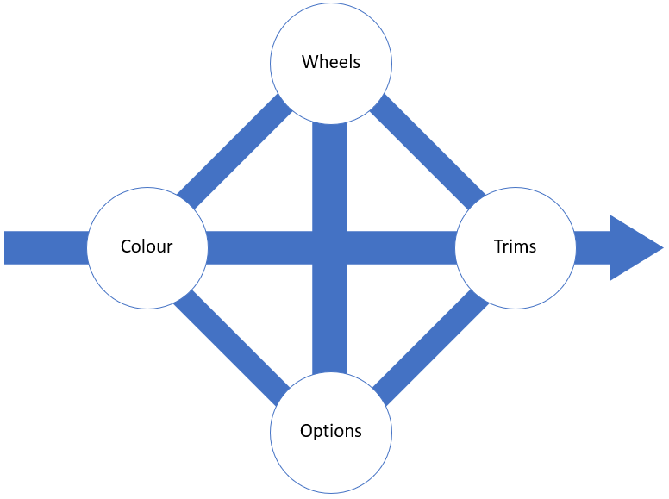
Controlled Evaluation
If the user explorers a well defined product or service it is controlled
The interface and navigation focus on allowing a user to perform the task
Notes:
Controlled evaluation: A user wants to explore aspects of a well-defined product or service. For example, let's say you are buying a car and want to evaluate combinations of different wheels, engines, trims, and options. The interface and navigation can focus just on allowing you to do these things in a controlled environment until you reach an outcome.

Slide 28
Complex Evaluation
Complex evaluations occur when users have unrelated needs
  For example when booking a holiday the user may evaluate:
    Dates
    Locations
    Activities
    Cost
  Understanding the emotional goal is key
How far away?
When?
Which airport?
Which city?
Full-board?
Specific needs

Slide 29
EMOTIONAL NEEDS
What behaviour is driving the user?
  E.g. When buying a new car the response from friends may top the specification
Who or what are their influences?
  Are there other users involved and what other factors influence?
Content requirements?
  Through research identify what media is needed at different points in the journey
Existing barriers
  Have you identified other reasons users may not complete tasks?

Slide 30
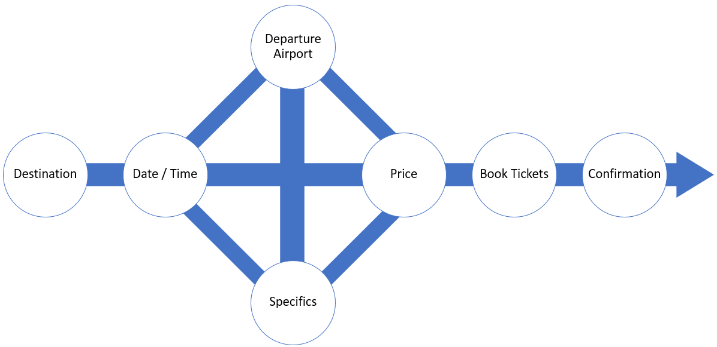

Example – Book a cheap flight to New York in July
“There are a few airports I could fly from”
“Normally I just want to book the flights and none of the shows or museum trips, but I do like to see what’s going on”
“I can be flexible with dates, but I’d prefer not to get up too early. And I need to Liaise with my sister in New York”
“I’m not necessarily after the cheapest, it’s a combination of things”
“I won’t look at the email again until just before I travel”
Katharine, 29
I want a hassle-free trip to New York to spend time with my sister and go shopping.
Must have an aisle seat, must not get up to early.
“I must have an aisle seat”
Users need to easily move between these different options in order to make an informed and confident decision.
Other people are often involved in the date / time discussion.

Slide 31
Activity: Task Analysis
In groups, take two of the scenarios you built earlier in this module and use task models in conjunction with the User Personas you created earlier in this course.

Slide 32
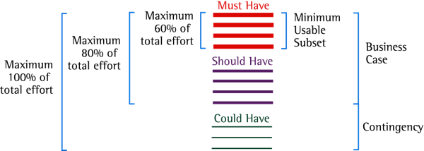
Prioritise - MoSCoW
You will have many tasks – it will be necessary to prioritise them
  The MoSCoW method can help with this:
    Must Have
    Should Have
    Could Have
    Won’t Have this time
Apply prioritisation based around mapped scenarios and user personas

Slide 33
Must Have - these provide the Minimum Usable Subset of requirements:
  This may be defined using some of the following:
    Cannot deliver on target date without this
    No point in delivering on target date without this
    Not legal without it
    Cannot deliver the Business Case without it
Should Have - Important but not vital
  May be painful to leave out, but the solution is still viable
  May need some kind of workaround
    e.g. management of expectations, some inefficiency
MoSCoW(2)

Slide 34
Nice to Have - wanted or desirable but less important
  Less impact if left out (compared with a Should Have)
Will not have this time - requirements which the project team has agreed it will not deliver
  Ensure they are recorded in the Prioritised Requirements List
  This helps clarify the scope of the project
  This helps to manage expectations
    Some requirements will simply not make it
MoSCoW(3)

Slide 35
Activity: Prioritisation
Take the scenarios you outlined earlier in the exercise and align them through MOSCOW prioritisation.

Slide 36
Review
The scope planes takes the findings from the strategy plane
Then applies some more formal analysis to the data
  Setting deliverables, ensuring processes are understood

